Slide 1

Requirements

Slide 2


Slide 3
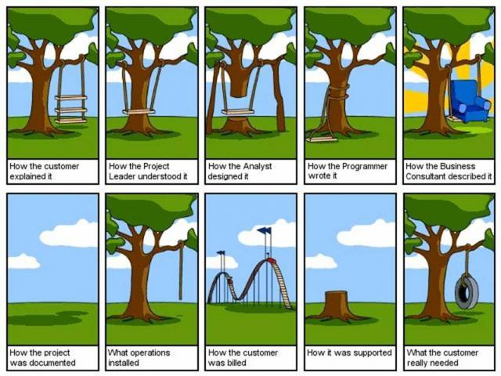

Slide 4

Requirement Engineering
It is the practice of collecting the requirements of a system from users, customers and other stakeholders.

Slide 5

Types of Requirements
Business Requirements
User Requirements
Software Requirements
  Functional Requirement
  Non Functional Requirement
Notes:
Business requirement:
What kind of information drives?
Who is going to generate information?
From where information comes and goes?
How?

Slide 6
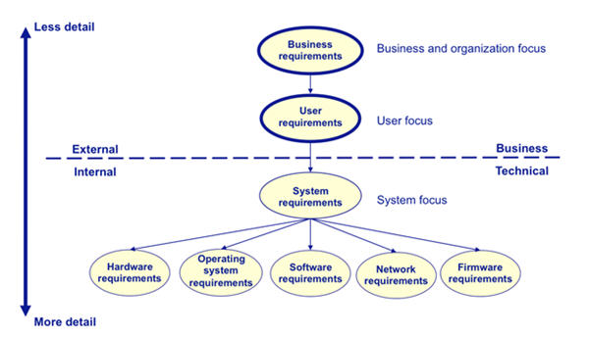

Slide 7
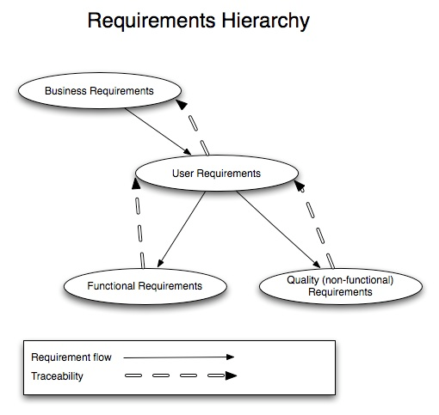

Slide 8
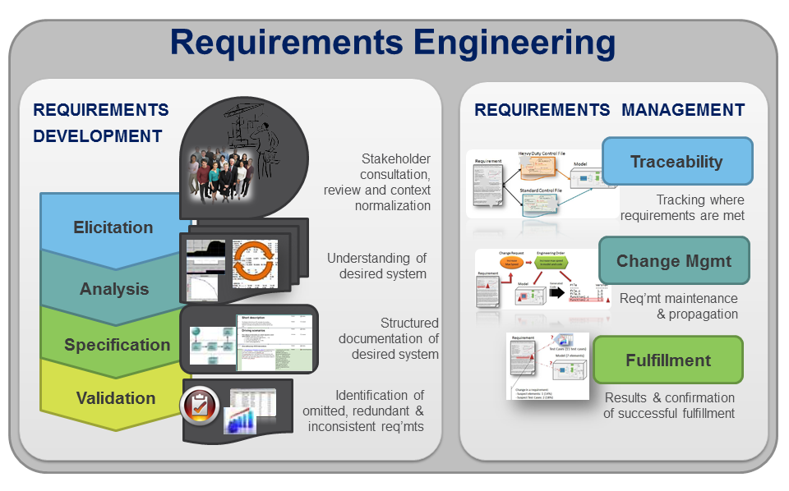

Slide 9
What is UML?
Unified Modeling Language (UML) is a standardized, general-purpose modeling language in the field of software engineering.
UML includes a set of graphic notation techniques to create visual models of object-oriented software-intensive systems
It was developed by Grady Booch, Ivar Jacobson and James Rumbaugh at Rational Software in the 1990s.
It was adopted by the Object Management Group (OMG) in 1997, and has been managed by this organization ever since.
In 2000 the Unified Modeling Language was accepted by the International Organization for Standardization (ISO) as industry standard for modeling software-intensive systems.

Slide 10
Unified Modeling Language (UML) combines techniques from data modeling (entity relationship diagrams), business modeling (work flows), object modeling, and component modeling.
It can be used with all processes, throughout the software development life cycle, and across different implementation technologies.

Slide 11
The Unified Modeling Language (UML) offers a standard way to visualize a system's architectural blueprints, including elements such as:
activities
actors
business processes
database schemas
(logical) components
algorithms
reusable software components.

Slide 12
Advantages of UML
Captures business processes
Enhance communication and ensures the right communication
Capability to capture the logical software architecture independent of the implementation language
Manages the complexity
Enables reuse of design

Slide 13
OOAD with UML
Building a house
Design and layout
Blueprint
Actual construction
Building software
OOAD
UML
Coding

Slide 14
A conceptual model of the UML:
To understand the UML, you need to form a conceptual model of the language, and this requires learning three major elements:
The UML’s basic building blocks.
The rules that dictate how these building blocks put together.
Some mechanisms that apply throughout the UML.

